Slide 1
GIS HOTELS & RESTURANTS IN MECCA
Prepared By:
1- Mohamed Sayed Osman
2- Mahmoud Khairy
3-Mahmoud Ahmed
4-Abdullah Mahfouz
5-Bassam Serag
6-Wagdy Yousry

Slide 2
Problem
ONE
We seek to provide a complete guide for expatriates in the holy city of Makkah, directing them to the locations of hotels and restaurants, as well as the locations of ATMs.

Slide 3
WE SHOULD :
HOTELS
we should give a complete informations about all hotels in mecca and we classified it from the rate,price ,also the location.
RESTURANTS
We also should give a complete view about this city resturants, and we gave the user the ablity to search for any kind of resturants, also he can find which one provide best services.
ATMs
Provide the user with the whole locations of ATMs, also he can search for specified Bank’s ATM.
MECCA STREETS
we should give the user a complete view of the city’s streets to enable him to move faster.

Slide 4
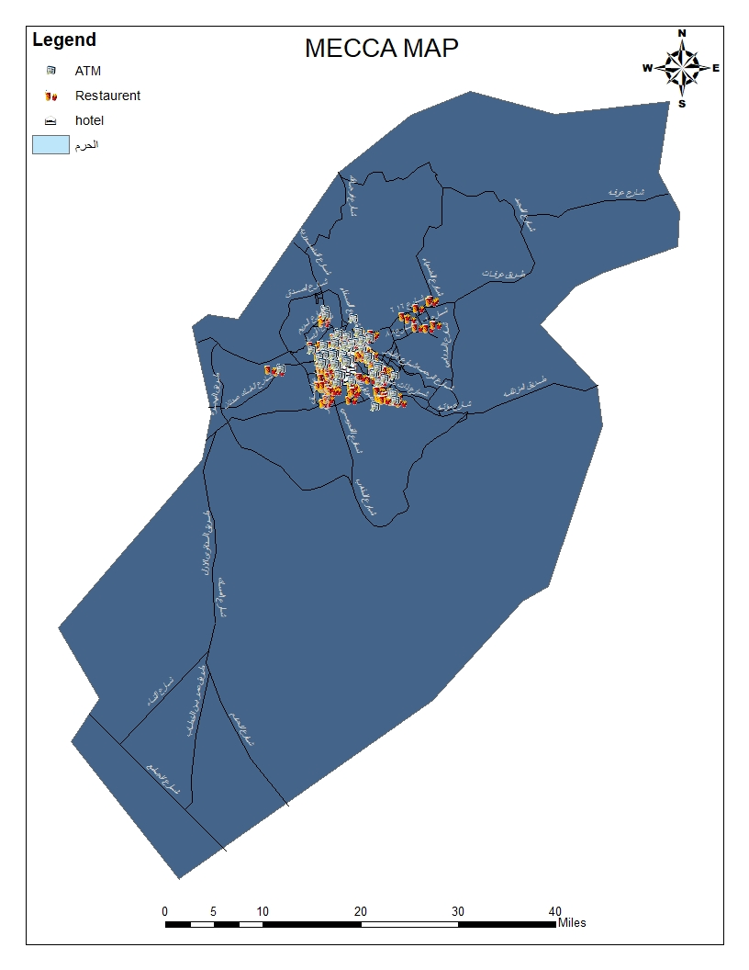
View Of Our Map
This is an quick view of the whole city map.
The map indicated The Locations of Hotels, Resturants, and ATMS and El-Haram.
We havn’t Yet dived in the details like finding the cheapest or higher rated Hotels or resturants,...etc

Slide 5
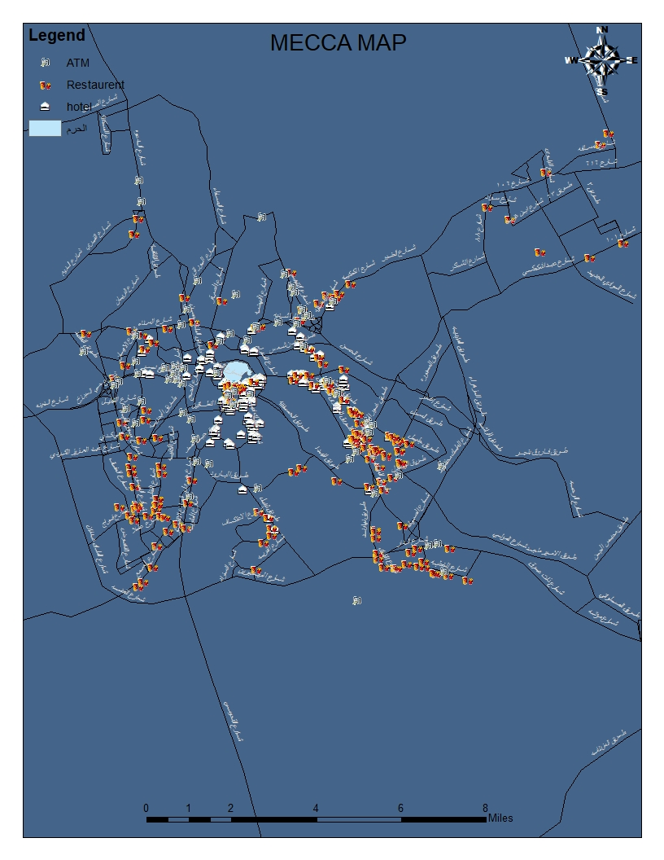

Slide 6
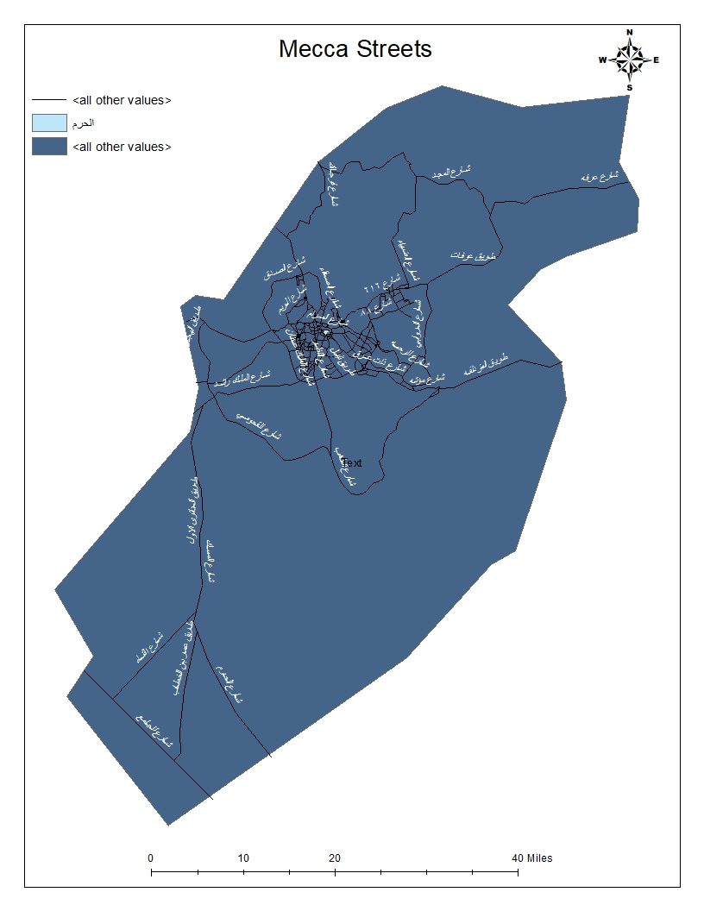
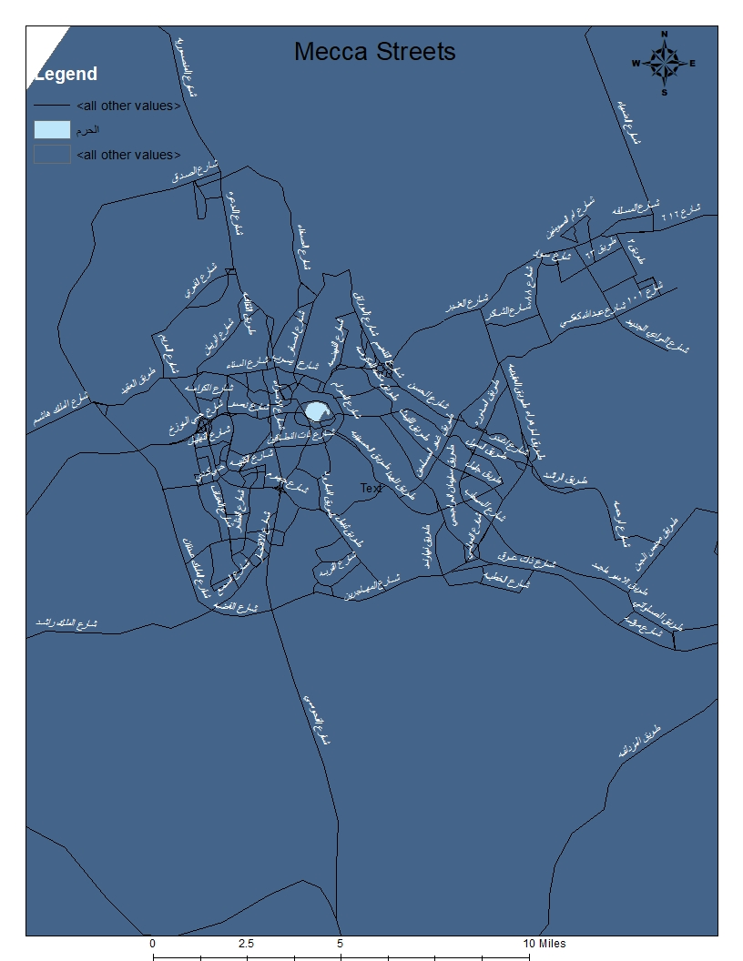
MECCA STREETS

Slide 7
HOTELS
TWO
We Provide som queries on Hotels in mecca, indication which ones are the top rated,cheapers,etc.....

Slide 8
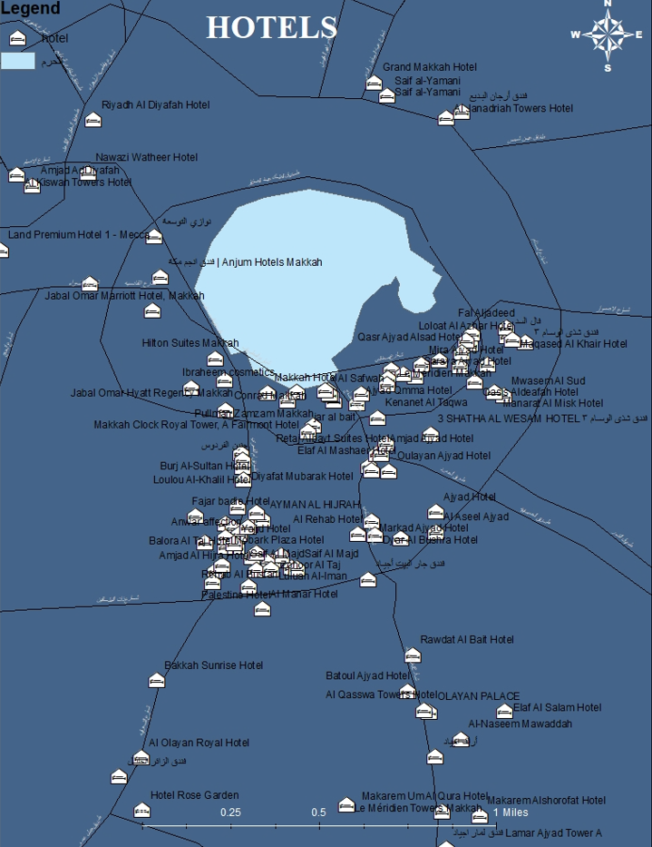
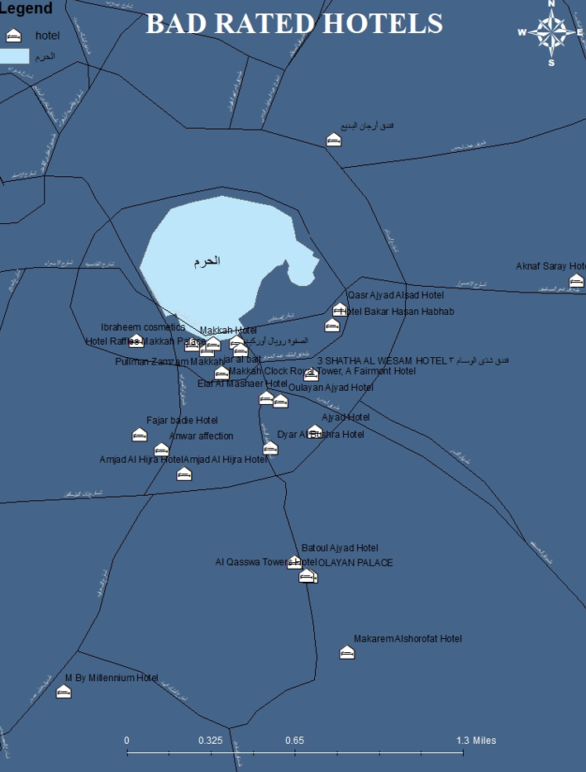
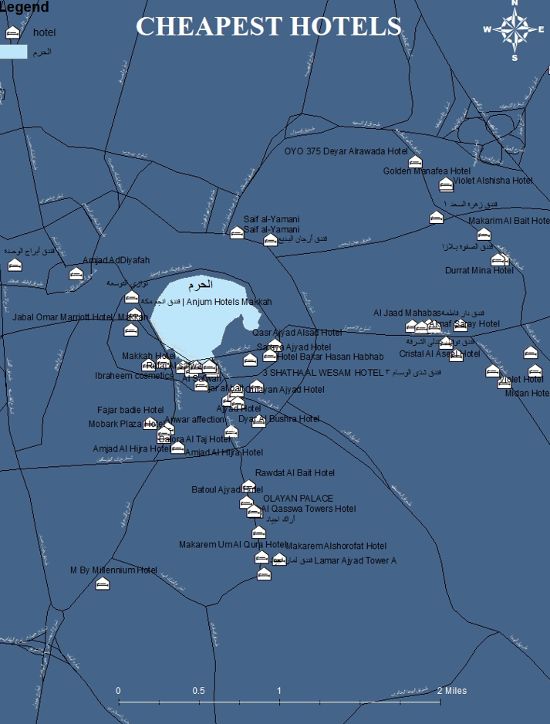
HOTEL
We provide the user with informarion about all Hotels in mecca city
Provide him with information Such as which Hotels are the top rated, cheaper , also which have the Top rated,and which is have the biggest capacity.
Also Which Are Near By EL-Haram.

Slide 9
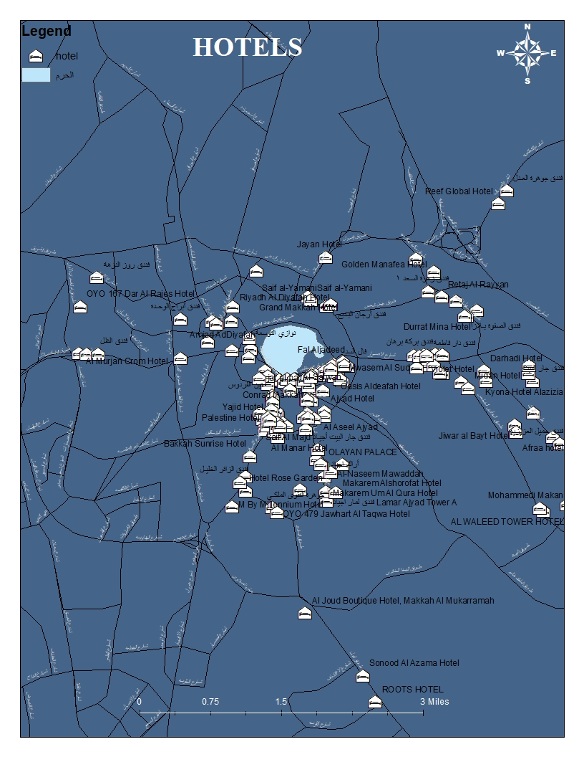
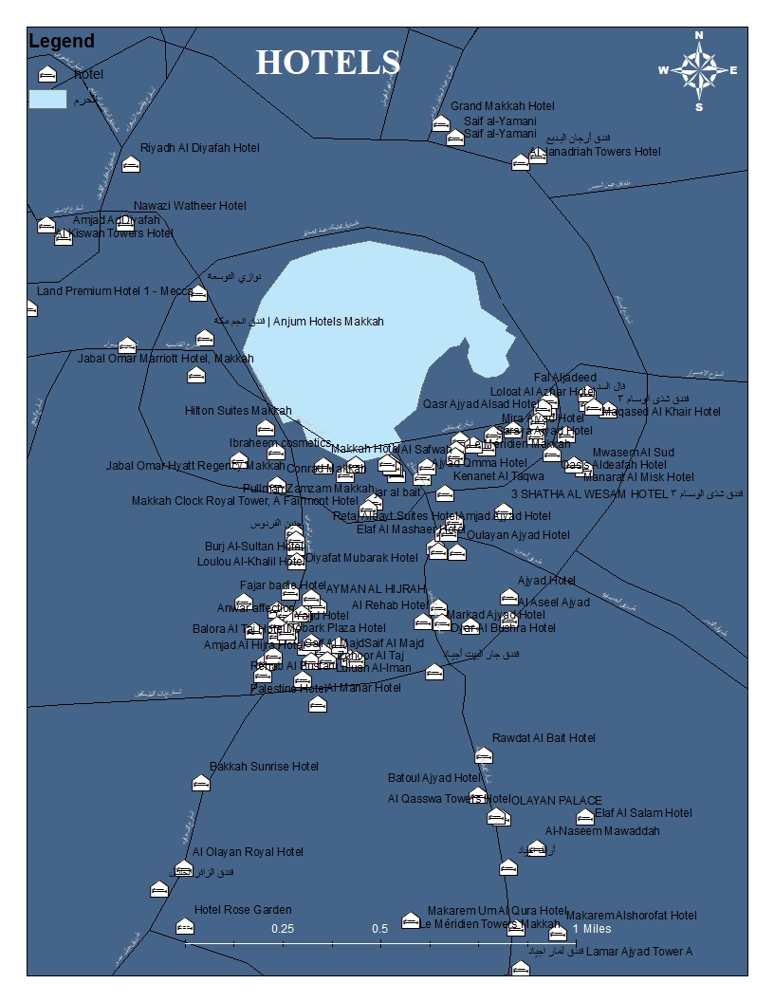
HOTELs

Slide 10
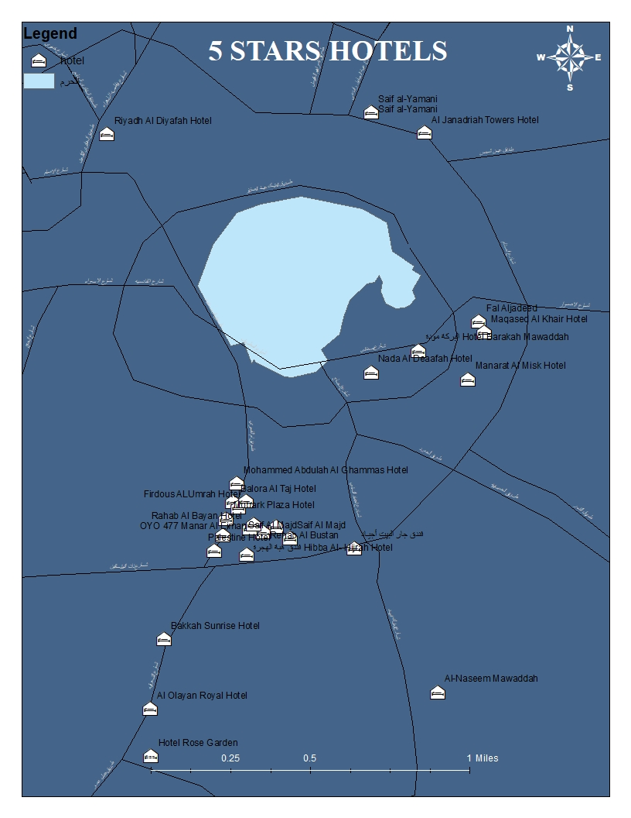
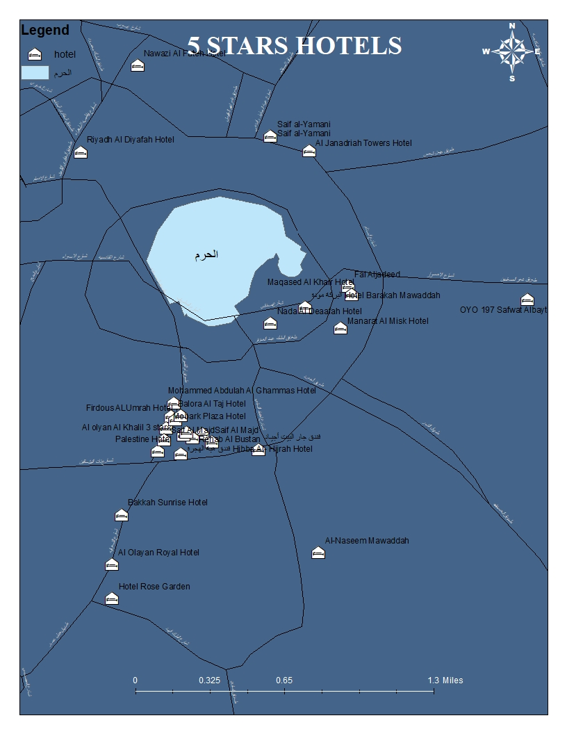
THIS IS THE TOP RATED HOTELS

Slide 11
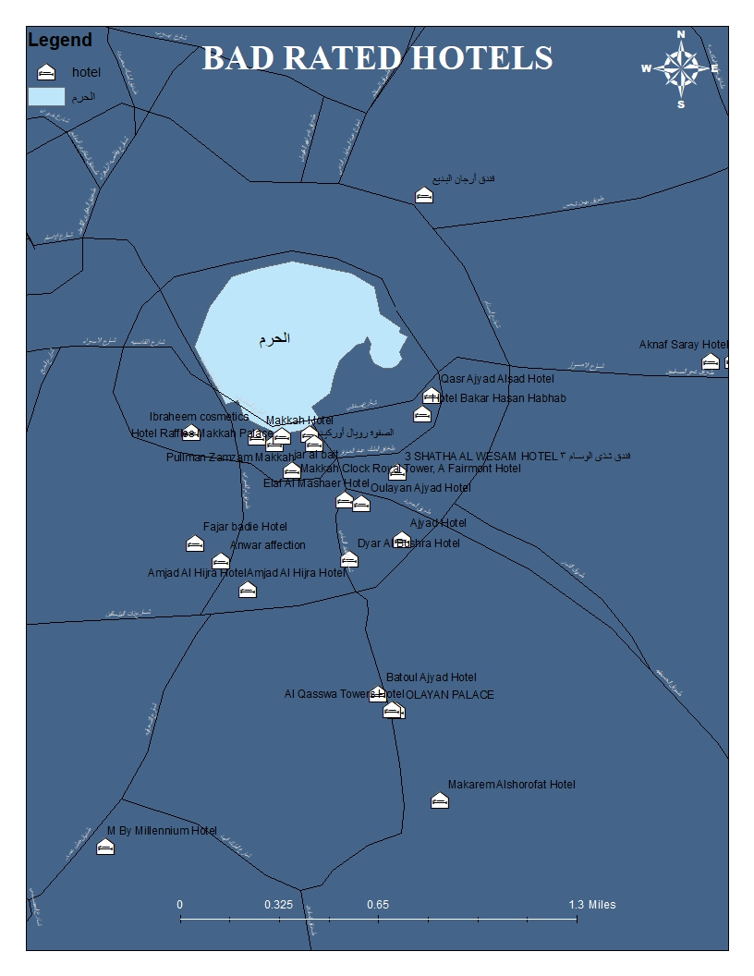
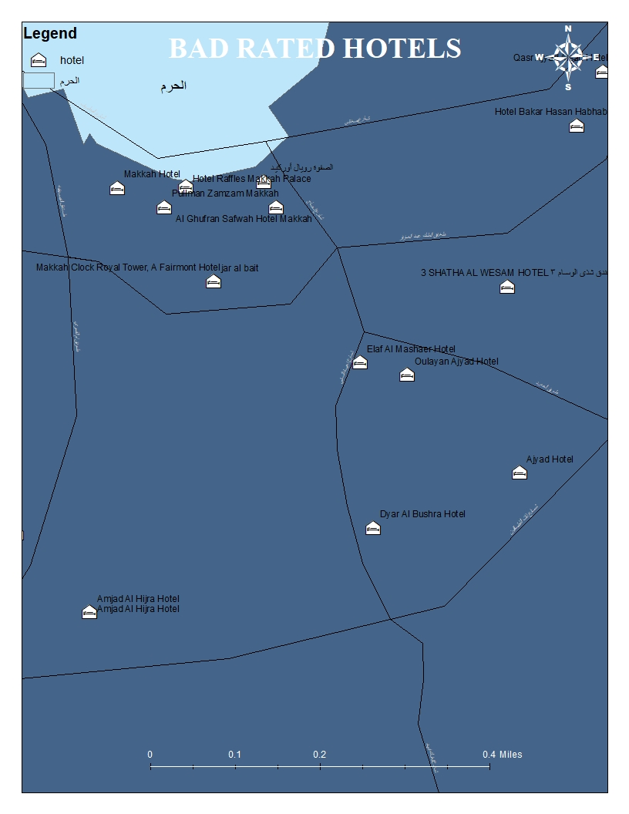
THIS IS THE LOWEST RATED HOTELS

Slide 12
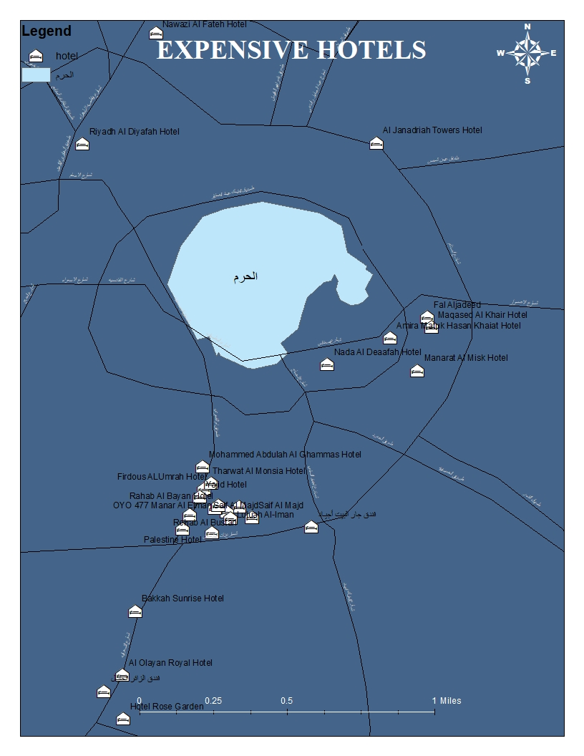
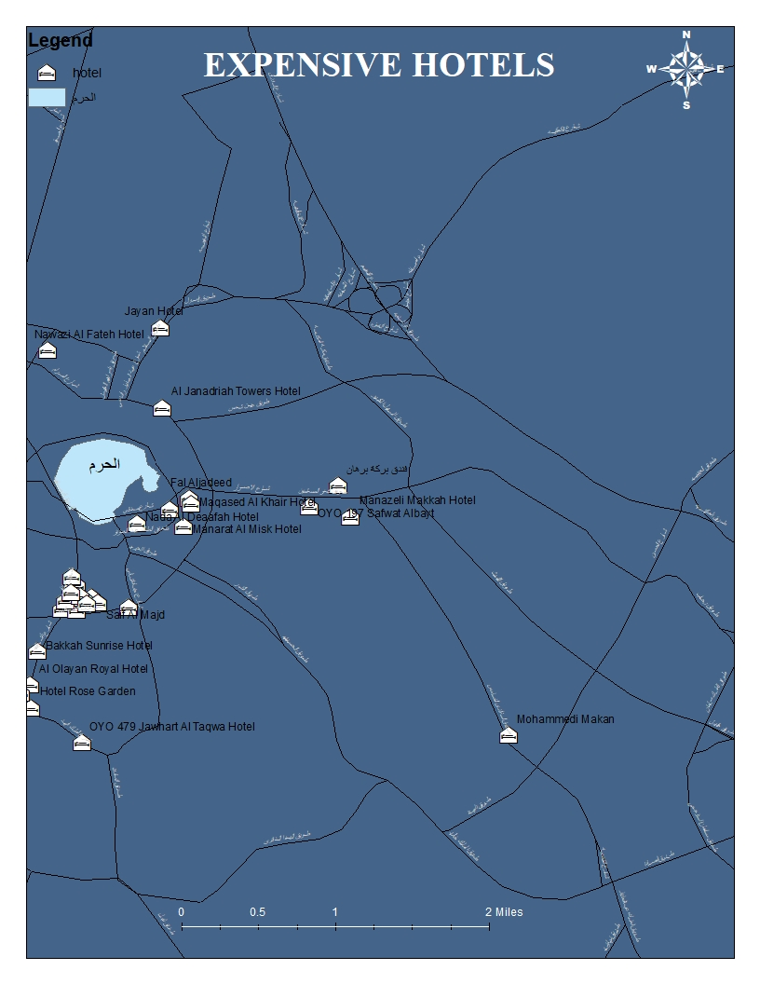
THIS IS Samples Of Highest Price HOTELS

Slide 13
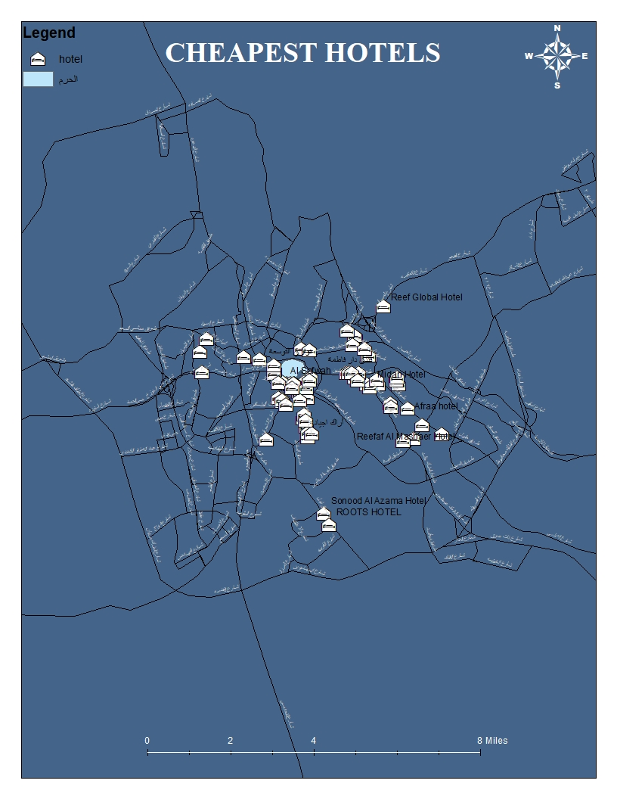
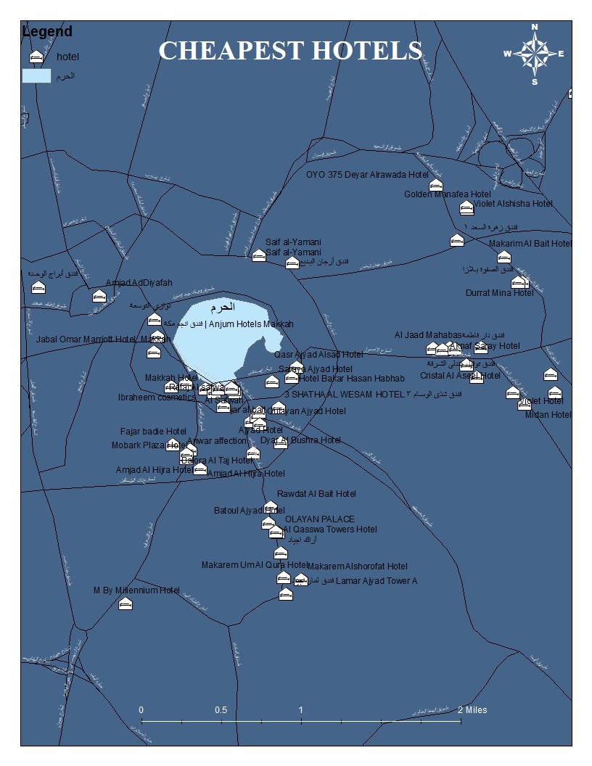
THIS IS THE CHEAPEST HOTELS

Slide 14
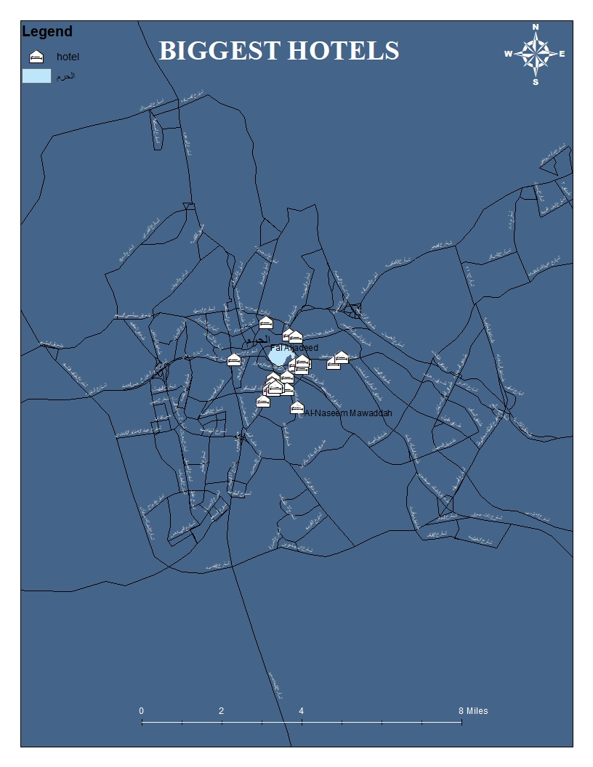
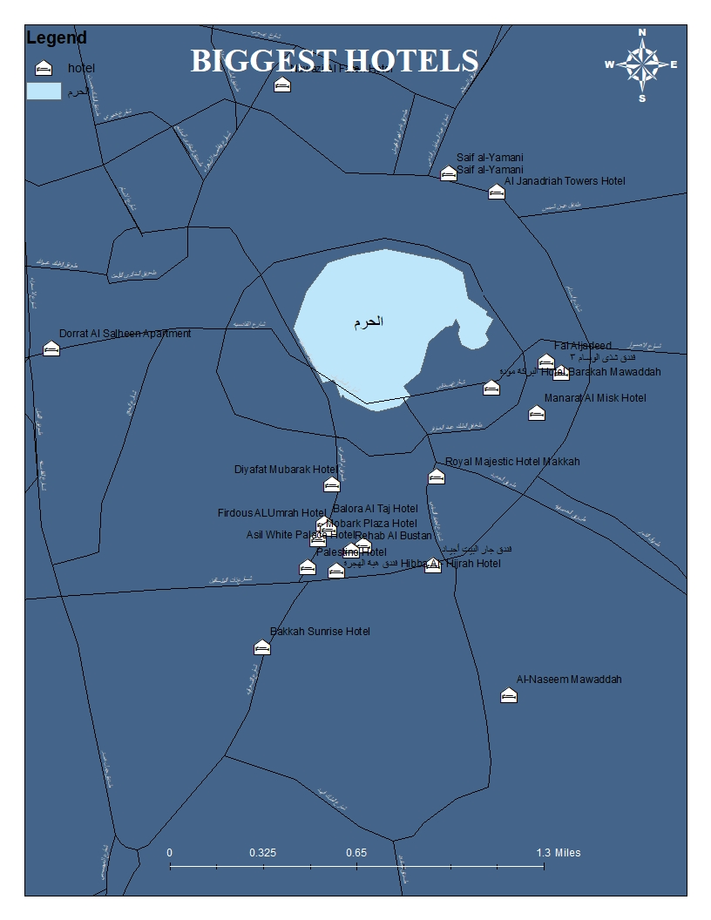
THIS IS THE BiGGEST HOTELS (in visitors capacity)

Slide 15
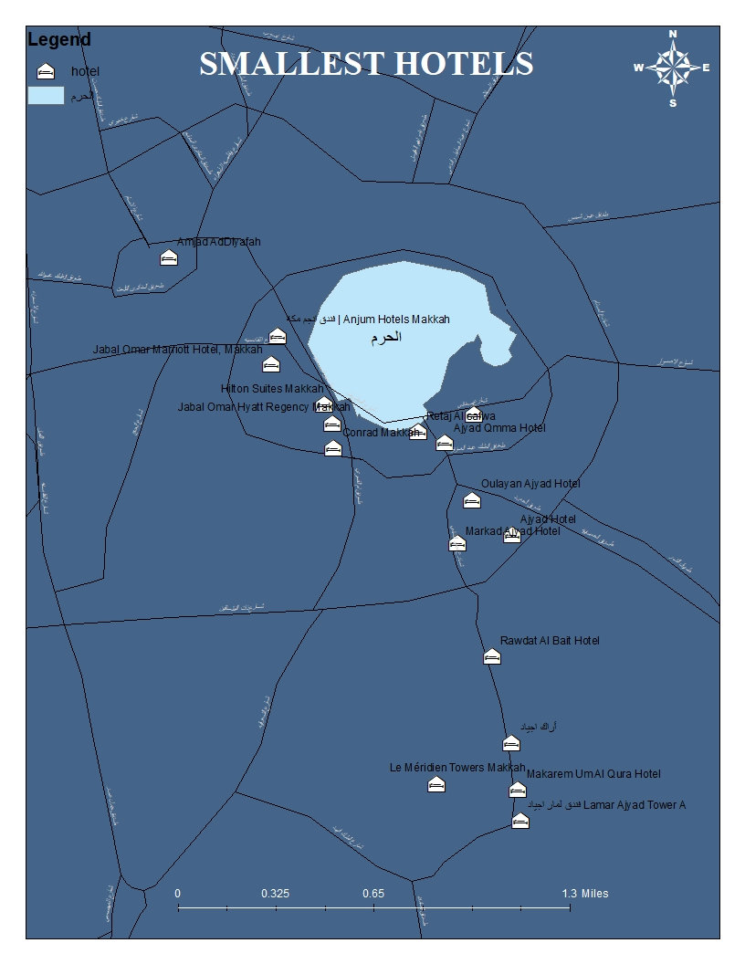
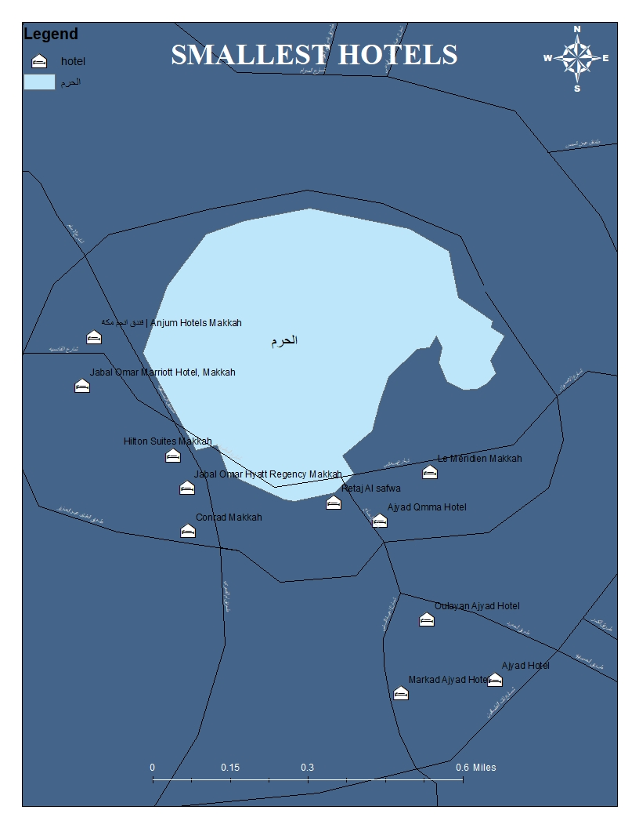
THIS IS THE SAMLLESTHOTELS (in visitors capacity)

Slide 16
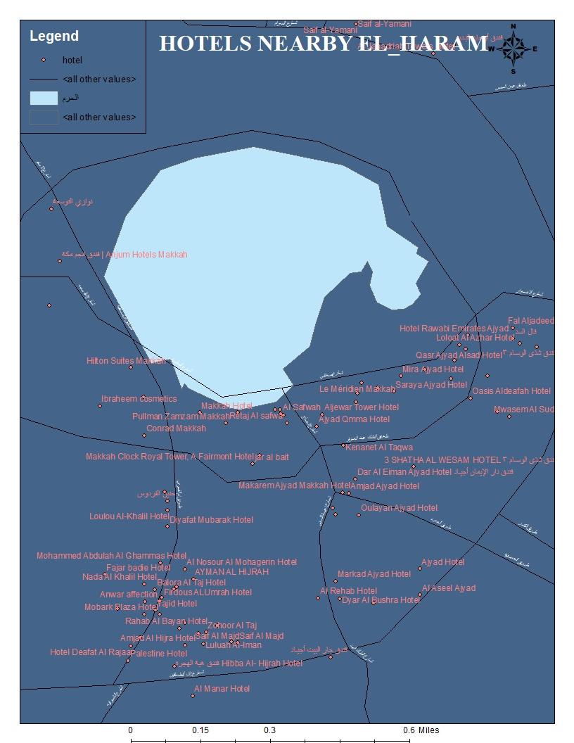
HOTELS NEAR BY El-HARAM (1km distance)

Slide 17
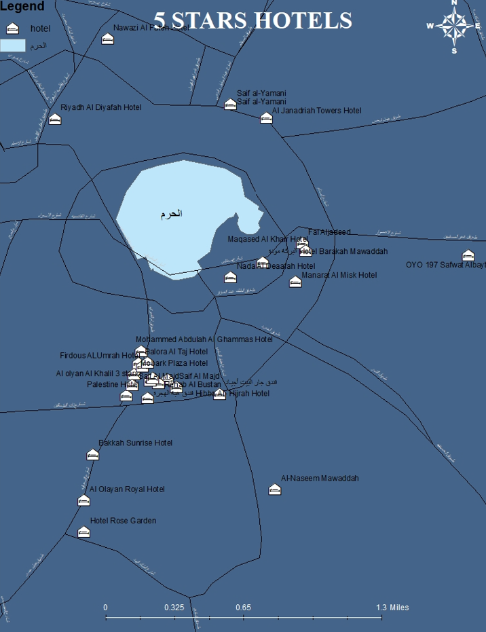
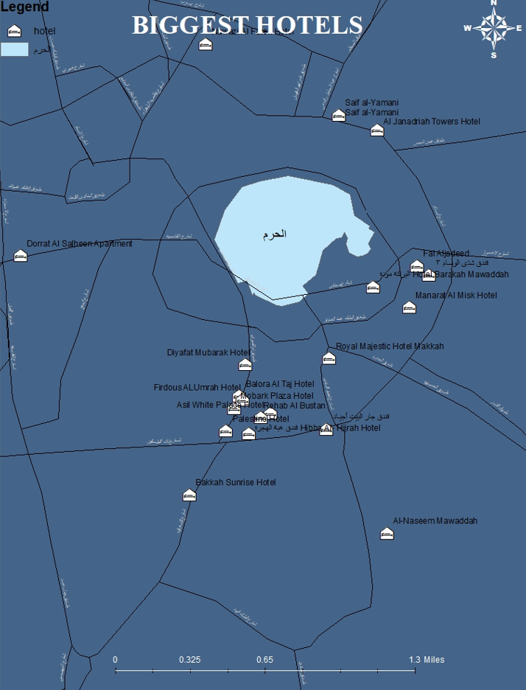
SUmmary
TOP RATED Hotels
Cheapest Hotels
WE Did gived The user a tip for the top rated hotels in mecca city. now he would be able to find the most beautiful hotels with the top customer service
This would Help ordinary Vistorts who just need to satisfy their normal requirements
Biggest and Smallest Hotels
Hotels nearby EL-HARAM
If the user want to stay near the HARAM
Give the user the opportunity to choose his prefered type.maybe he like the smallest hotels as a kind of comfortability

Slide 18
RESTURANTS
THREE
We Provide som queries on Resturants in mecca, indication which ones are the top rated,have the fastest delivery service,cheapers,etc.....

Slide 19
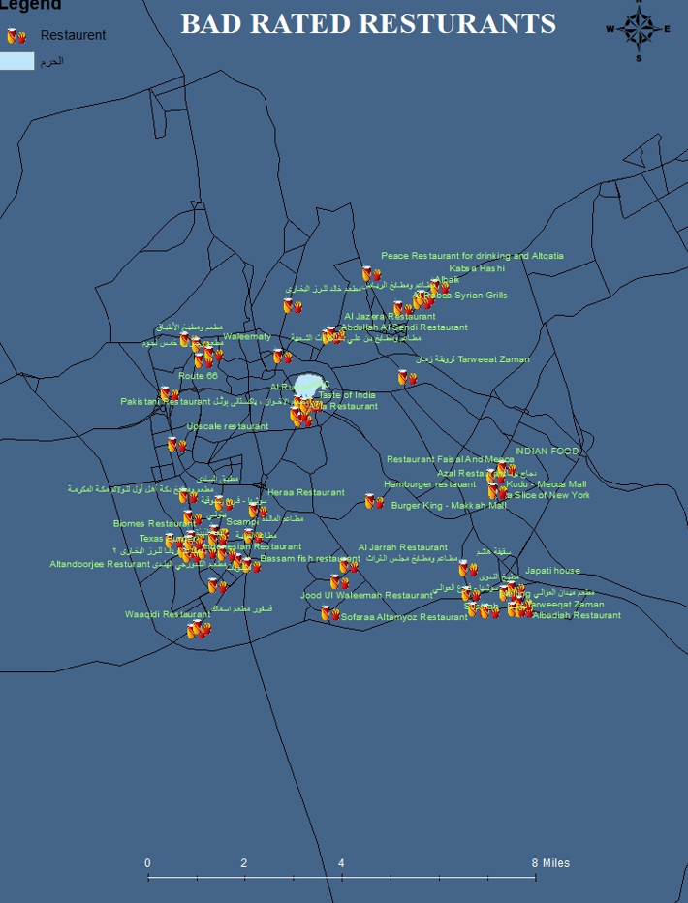
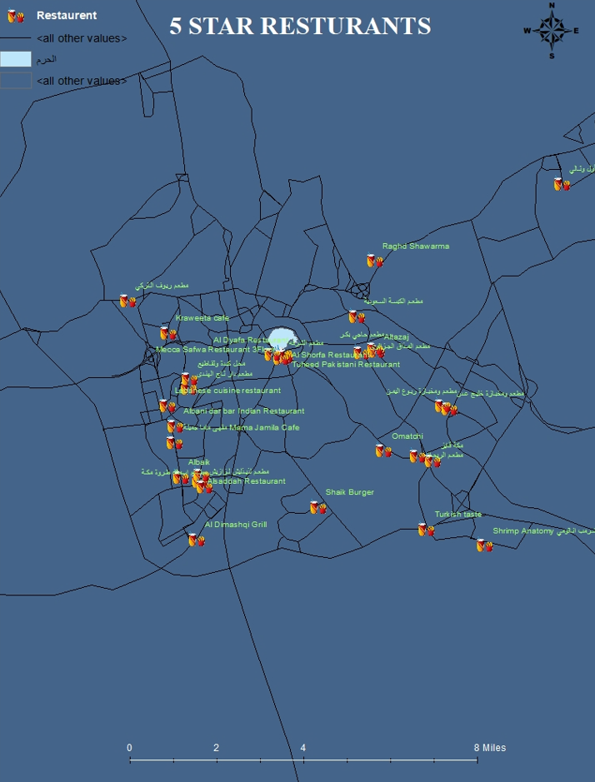
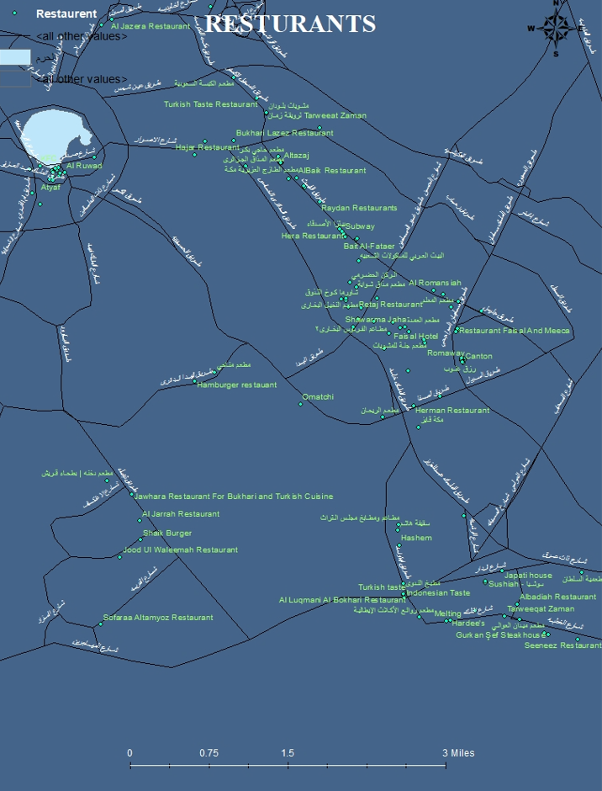
Resurants
We provide the user about all resturants in mecca city
Provide him with information Such as which resturants are the top rated, cheaper , also which have the fastest delivery Service.
Also Which Are Near By EL-Haram.

Slide 20
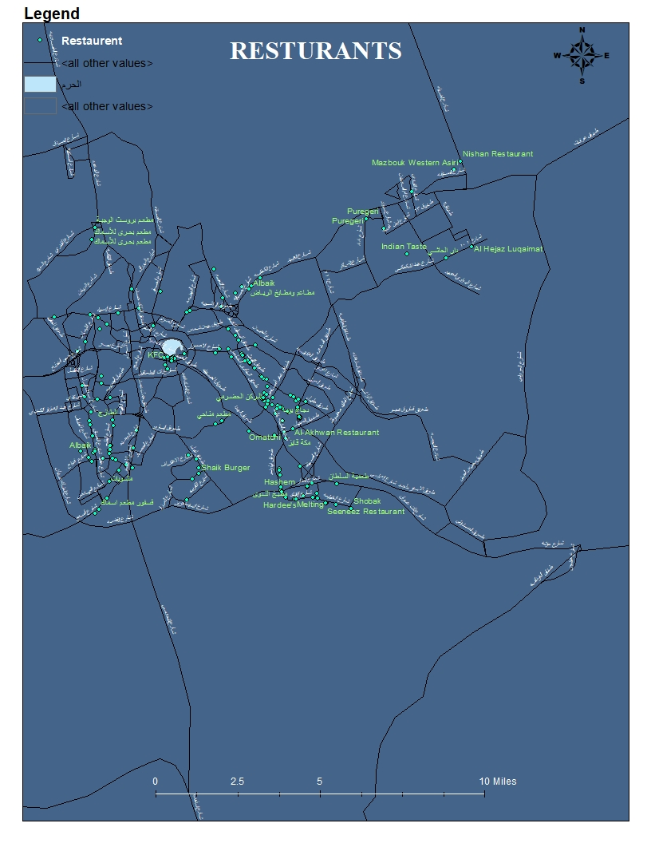
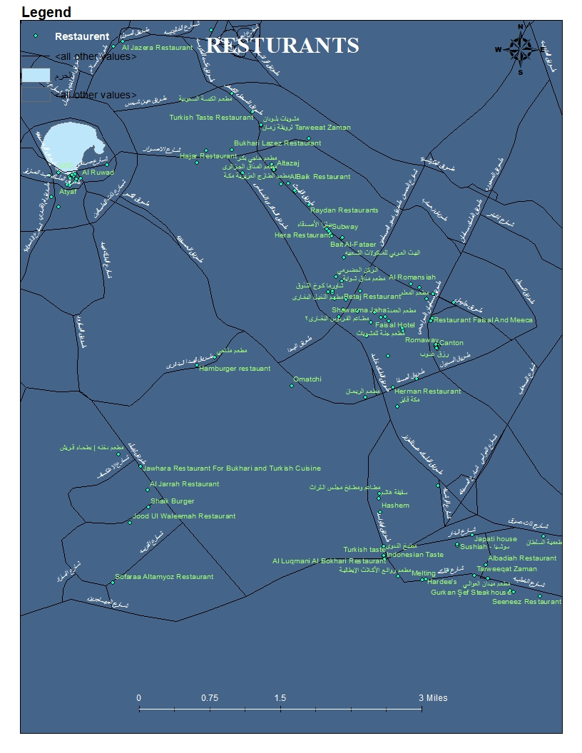
RESTURANTS

Slide 21
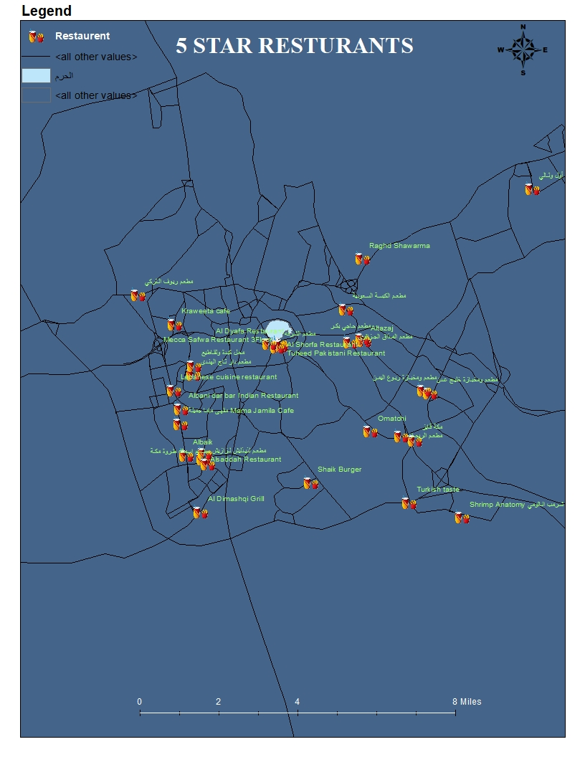
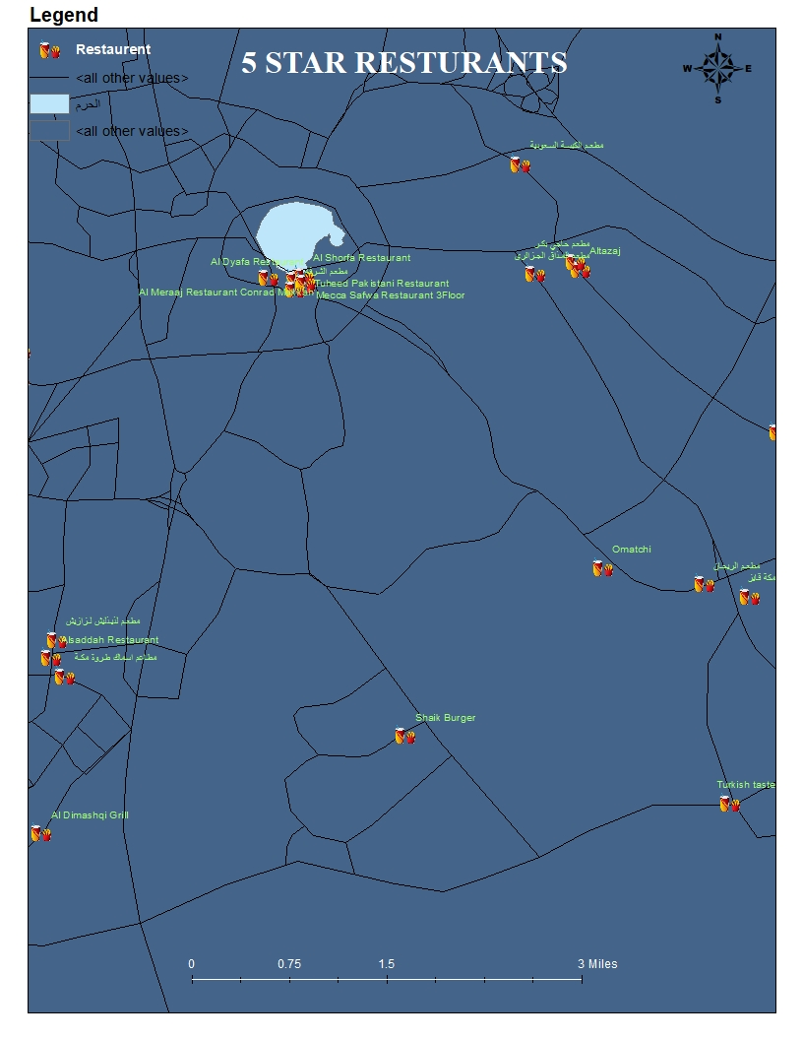
TOP RATED RESTURANTS

Slide 22
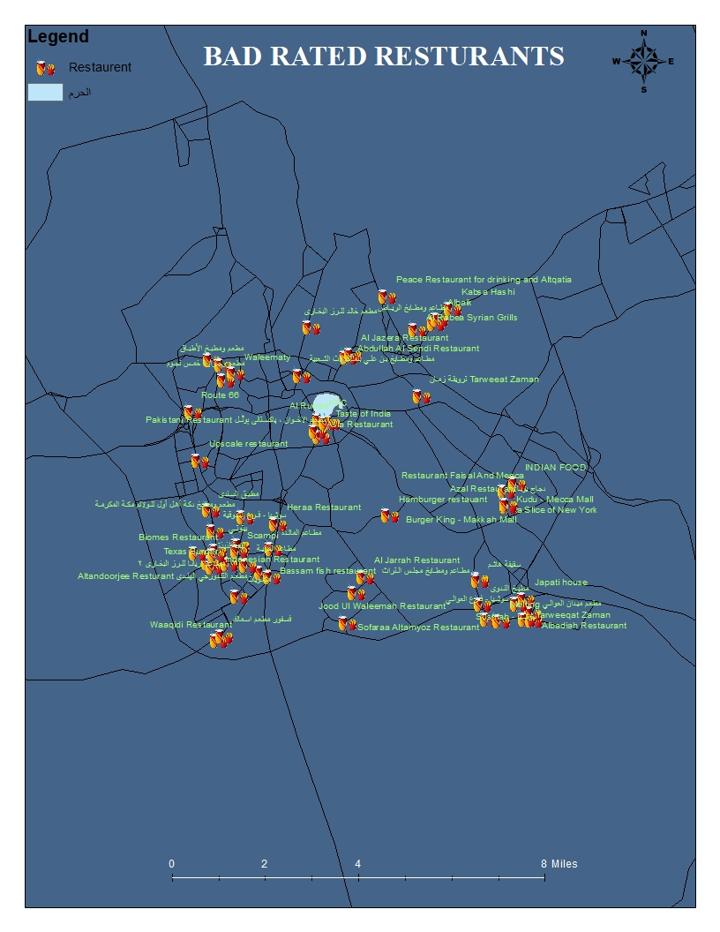
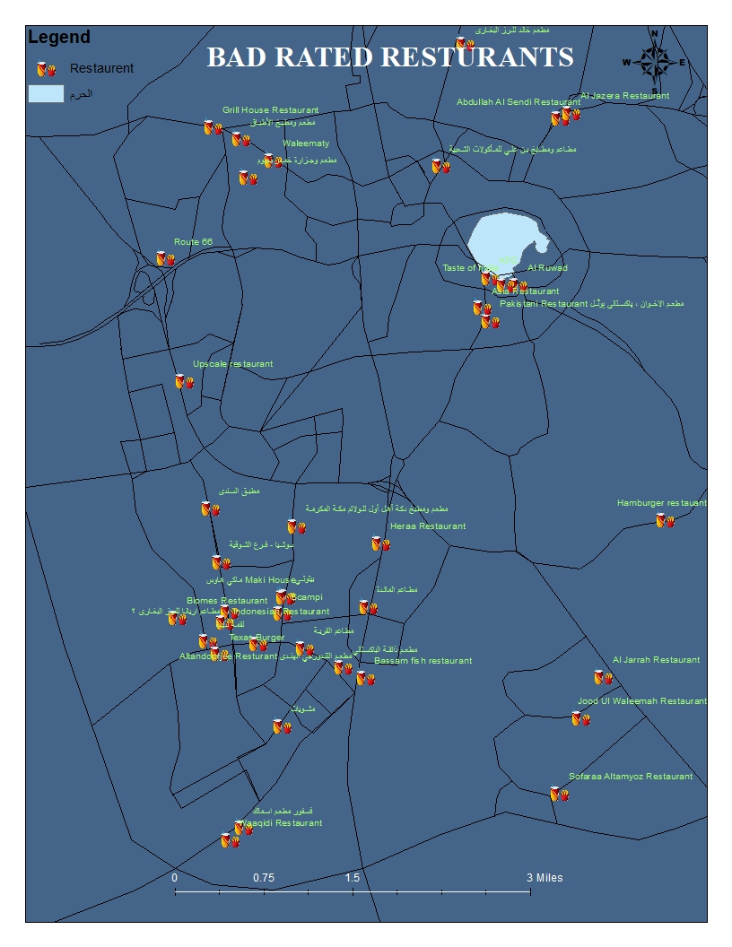
BAD RATED RESTURANTS

Slide 23
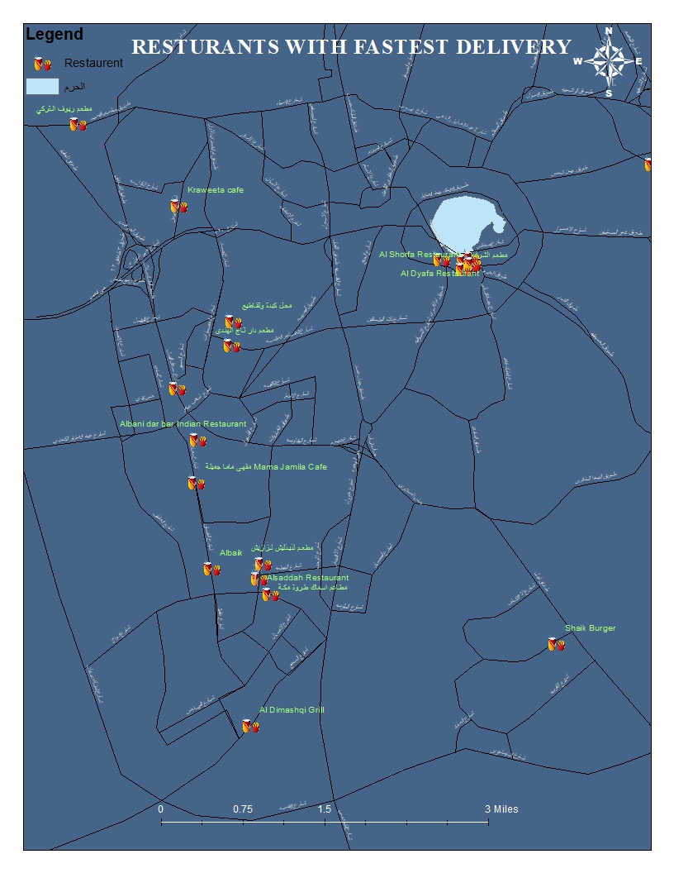
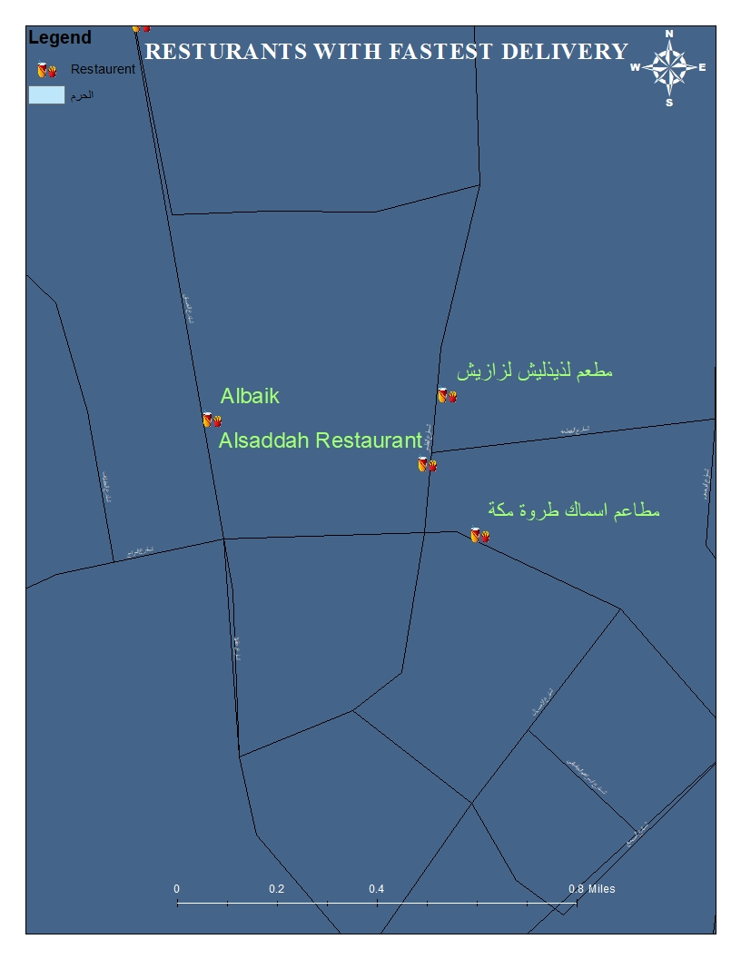
RESTURANTS WITH FASTEST DELIVER SERVICES

Slide 24
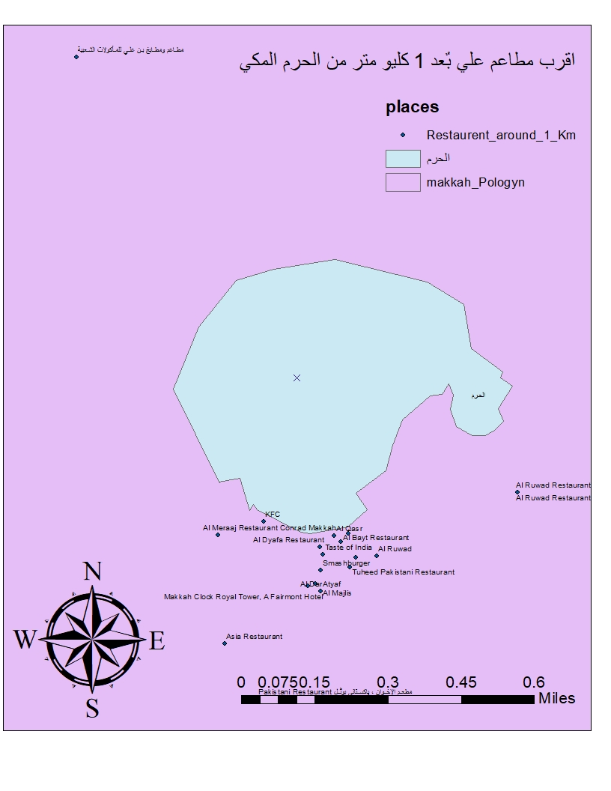
RESTURANTS NEAR BY EL-HARAM (1KM DISTANCE)

Slide 25
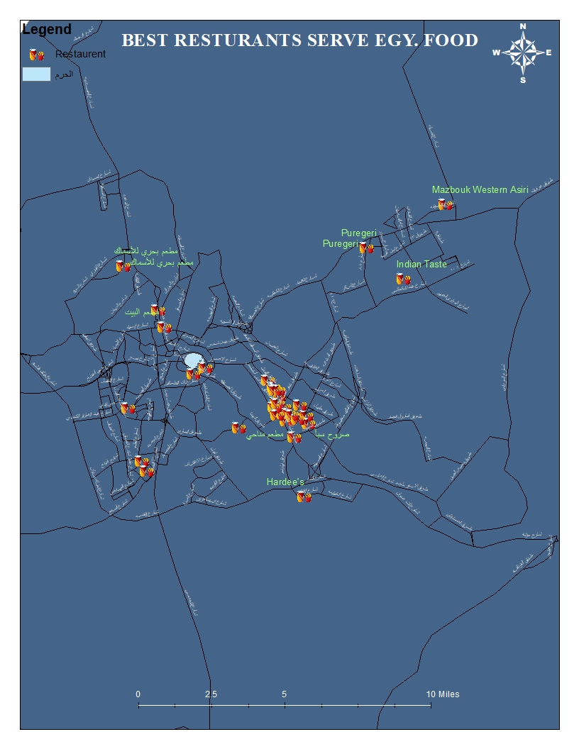
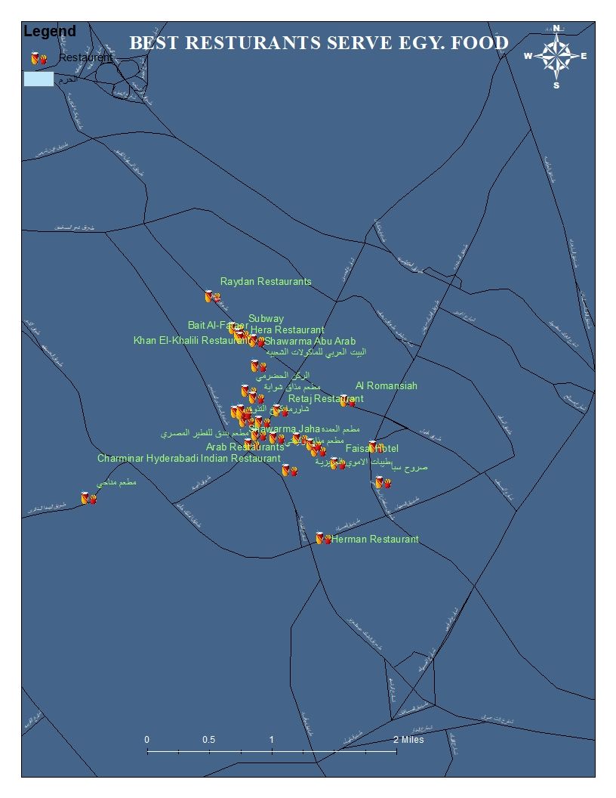
RESTURANTS PROVIDE BEST EQYPTIAN FOOD

Slide 26
SUmmary
Find Resturants Provide best french or egyptian , etc.... food
TOP RATED Resturants
WE Did gived The user a tip for the top rated resturants in mecca city. now he would be able to find the most beautiful resturants with the top customer service
Maybe he would like to try something new.
Resturants with best delivery serivce
Resturants nearby EL-HARAM
If the user have no time, definitly he will search for this type of resturants.
If the user doesn’t want to go far.

Slide 27
ATM
Four
We would give the help to the users to find the ATMs near by them..

Slide 28
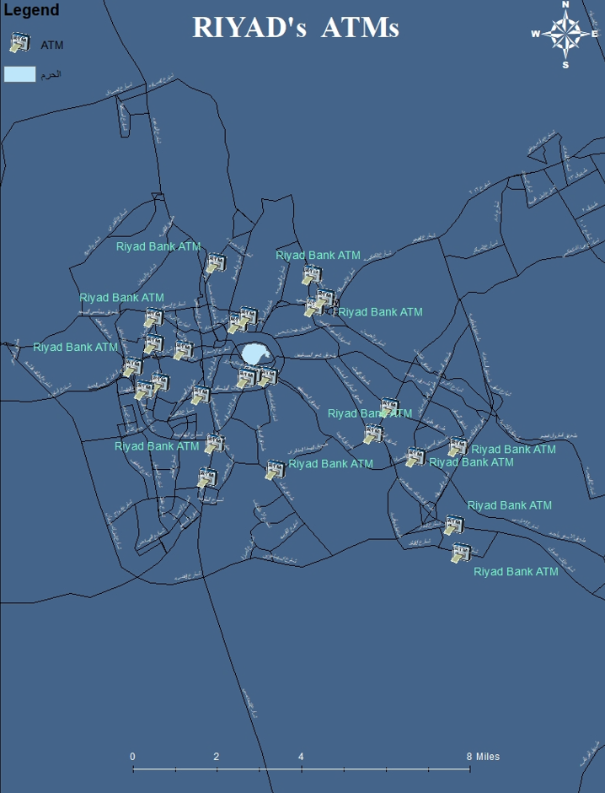
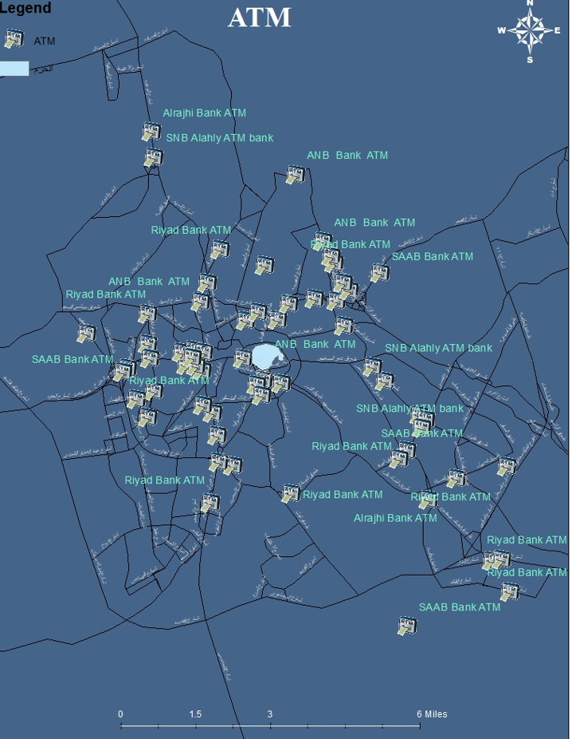
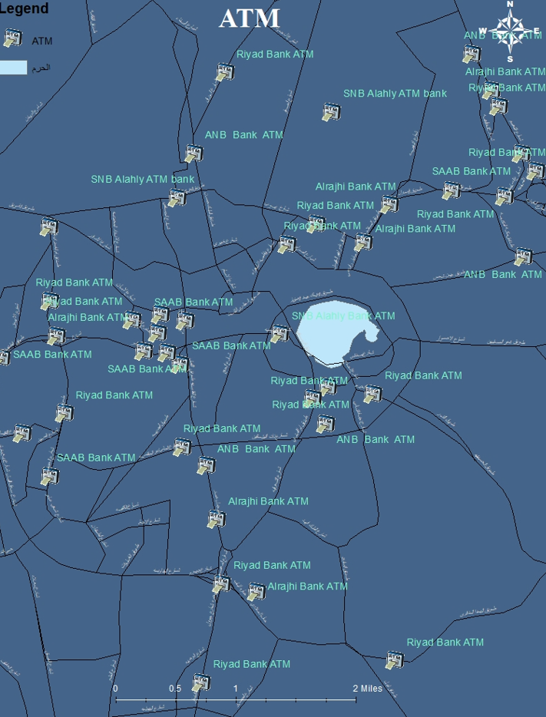
ATM
We provide the user about all ATMs in mecca city
Provide him with information Such as The Bank name, and which ATMs are near by him.

Slide 29
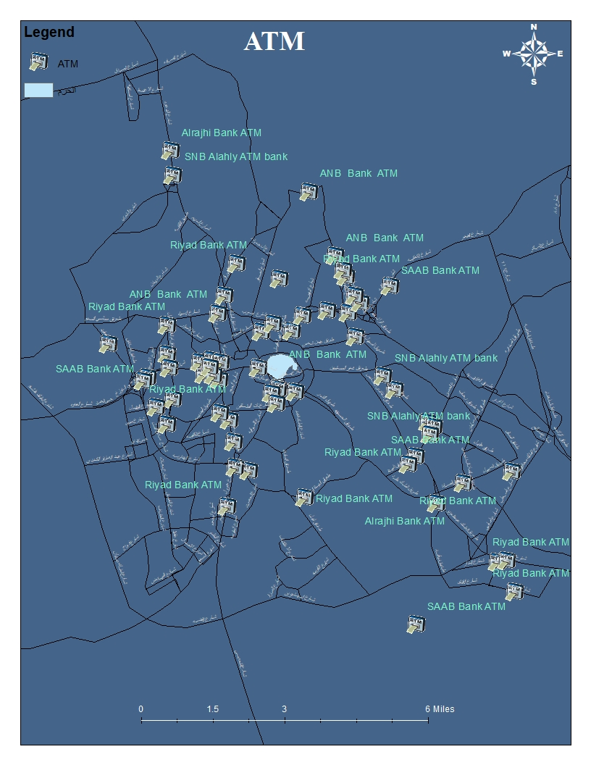
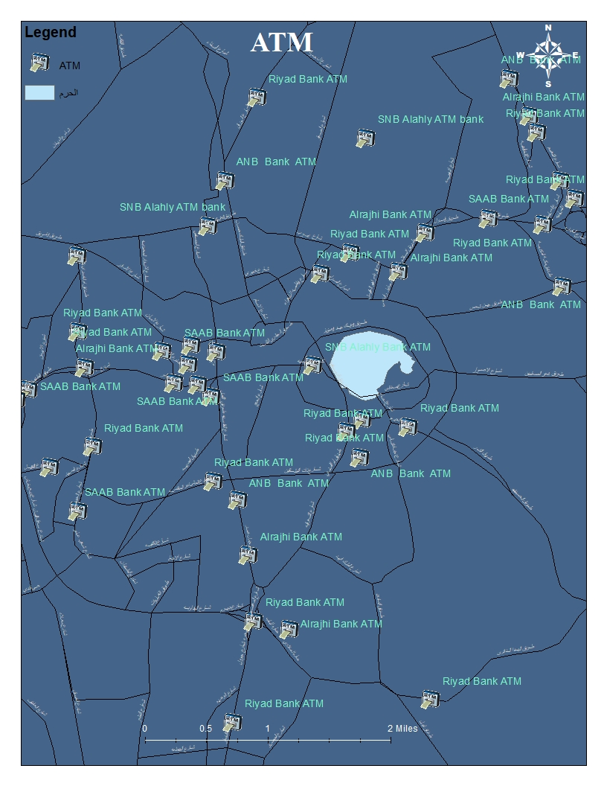
ATMs IN MECCA

Slide 30
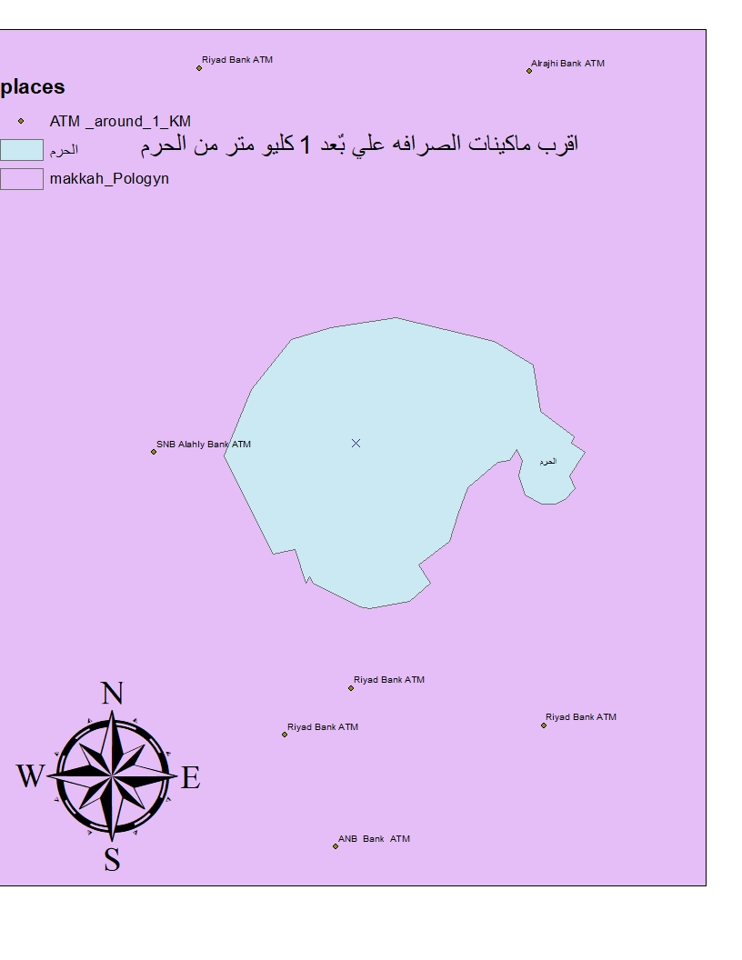
ATMs NEAR BY EL-HARAM

Slide 31
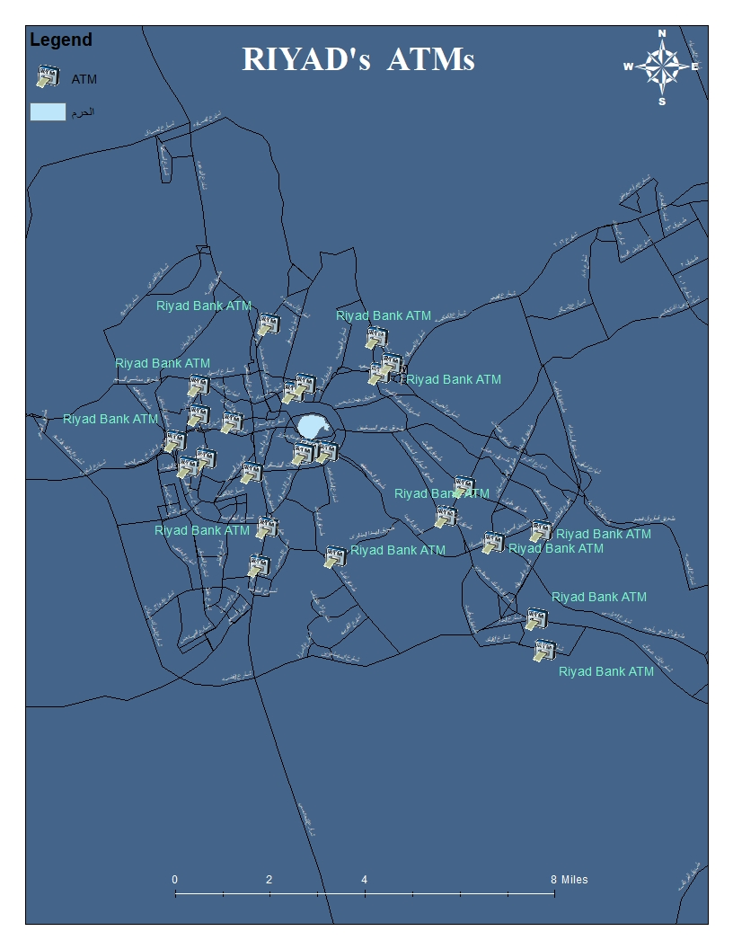
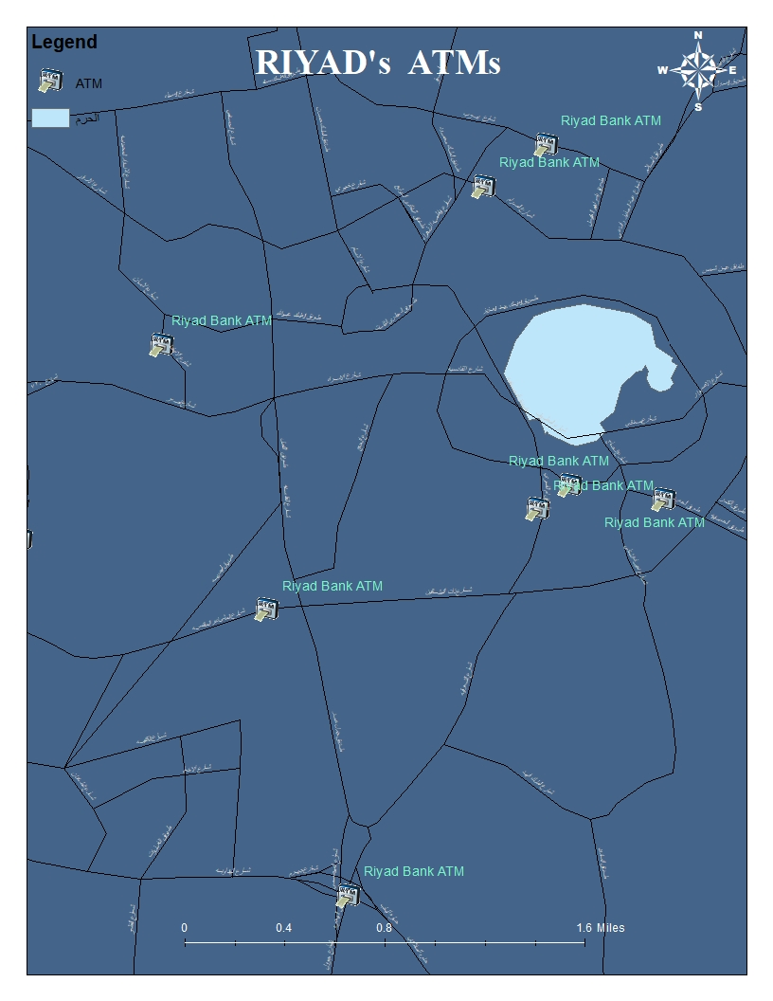
ATMs OF RIYAD BANK

Slide 32
SUmmary
ALL ATMs
Specified bank’s ATm
Now The user has the information about the locations of all ATMs in mecca.
The user can search for any bank’s ATM in mecca
ATMs Nearby HARAM
If the user doesn’t want to go far.

Slide 33
THANKS FOR READING
MADE WITH

